Slide 1


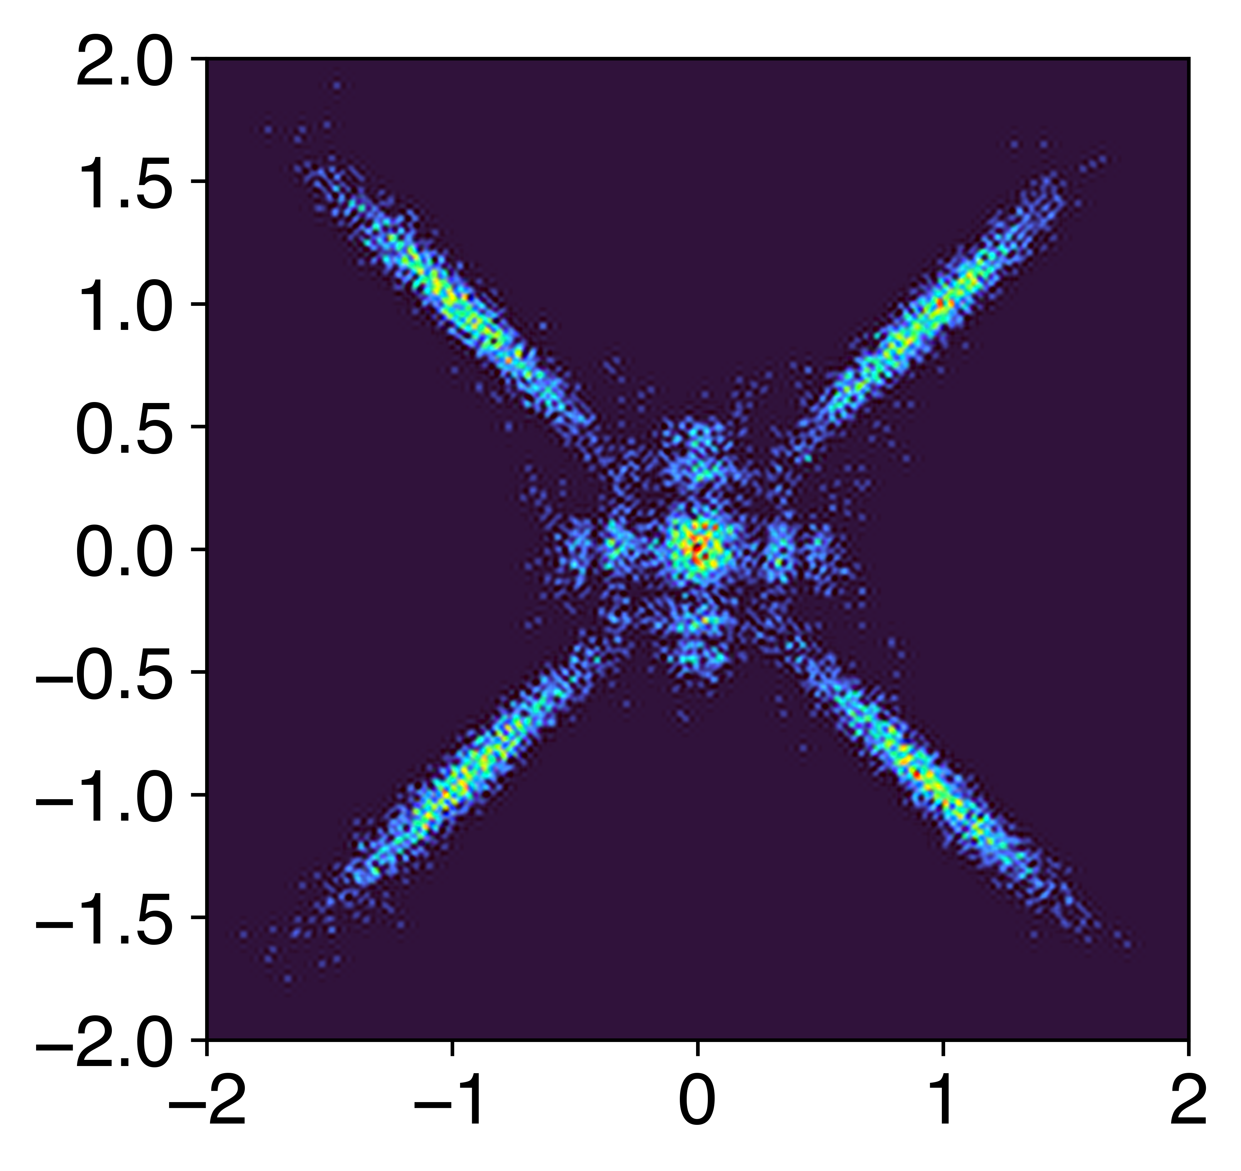
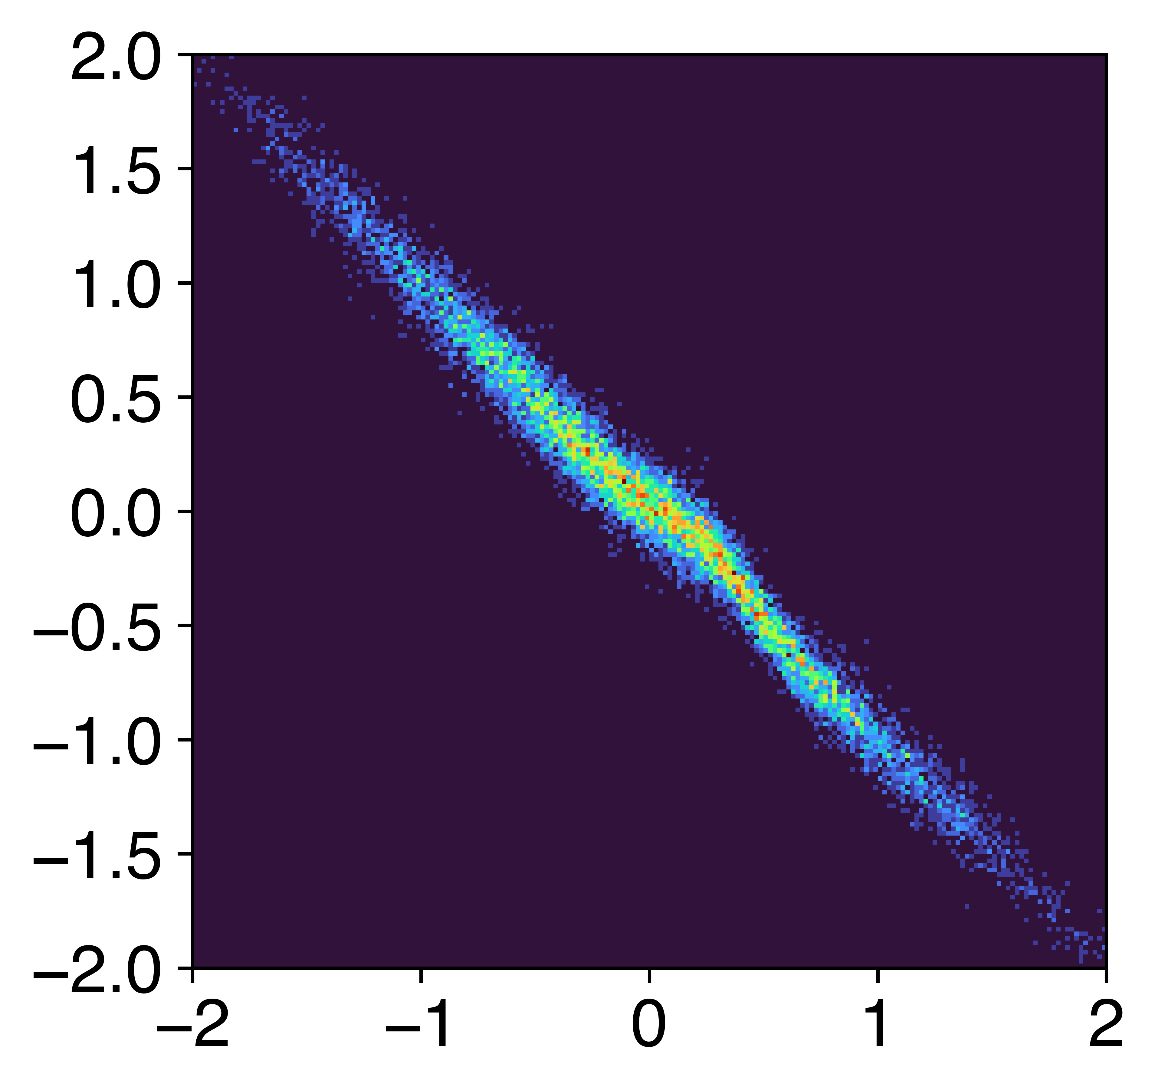
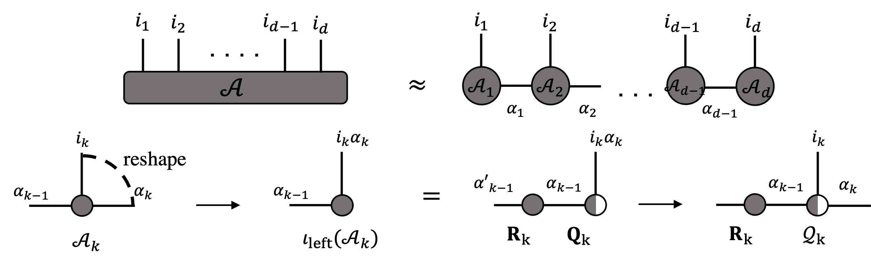
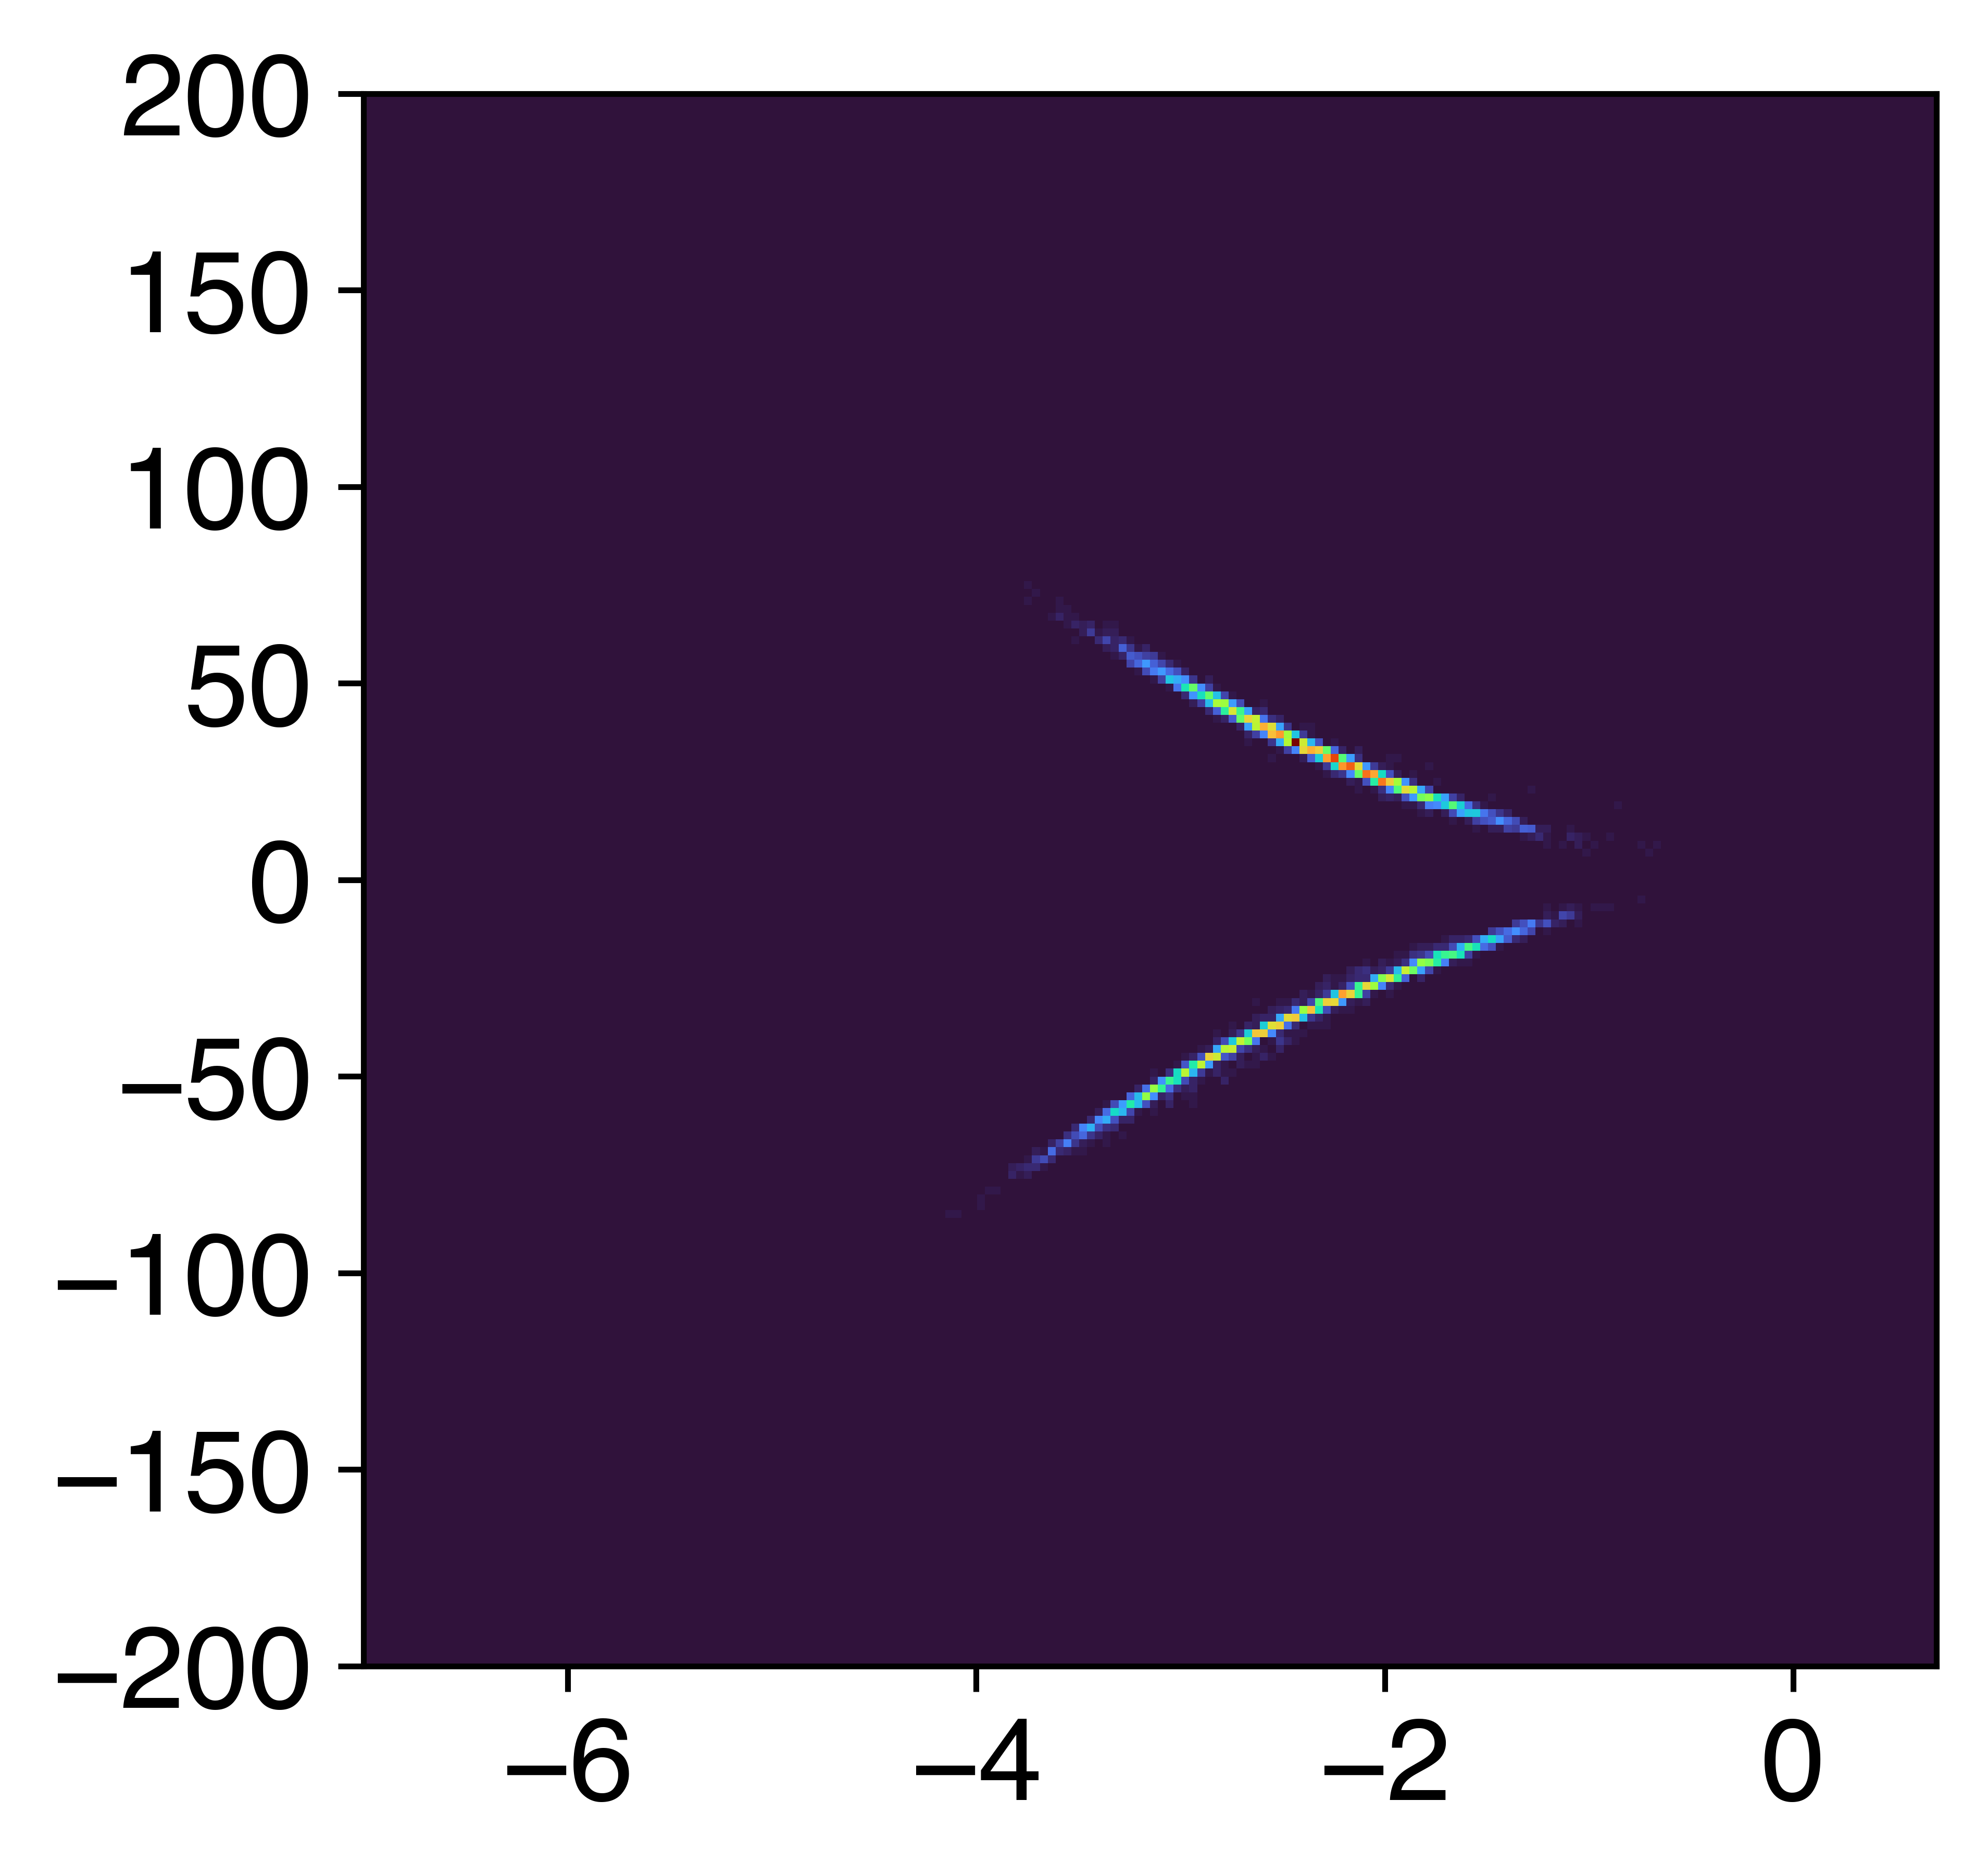

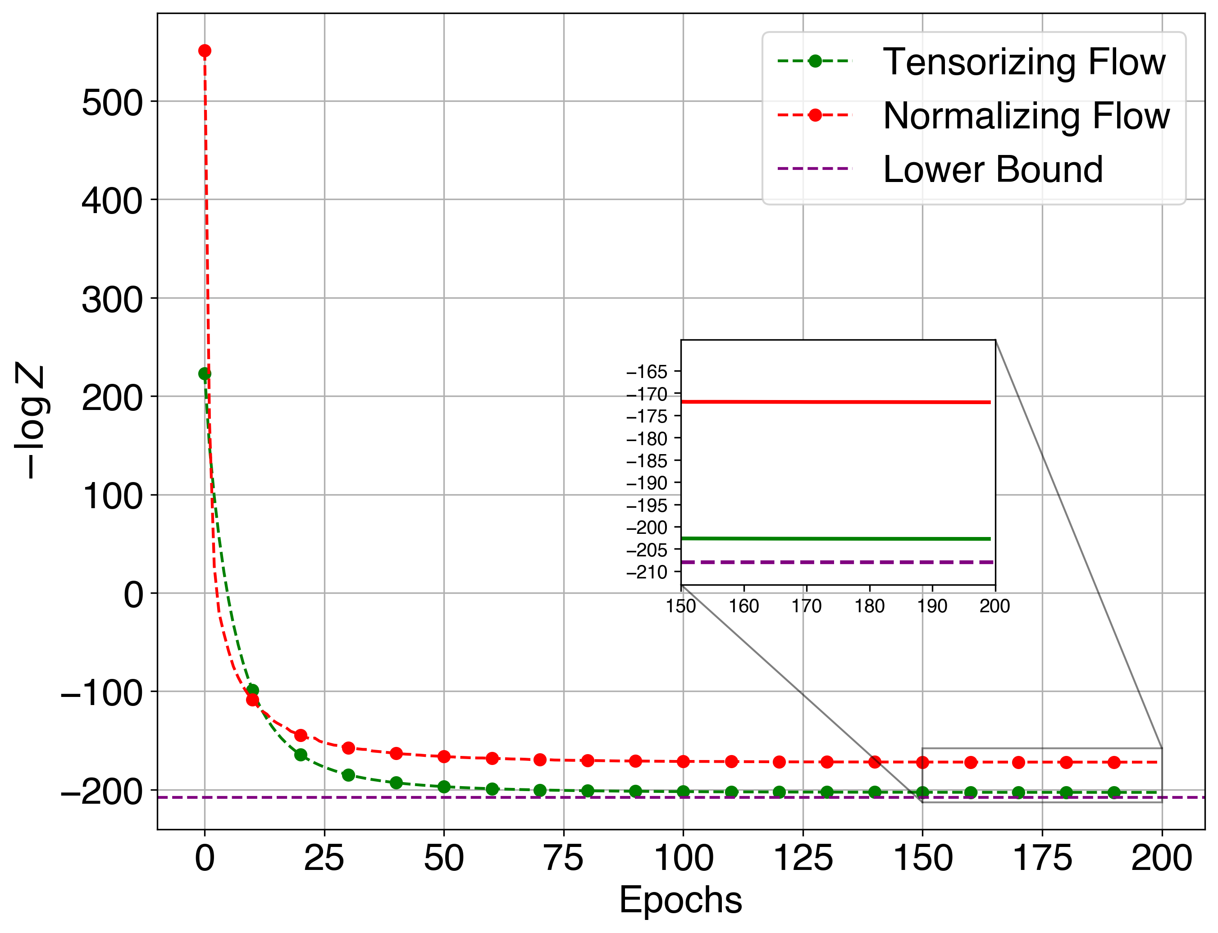
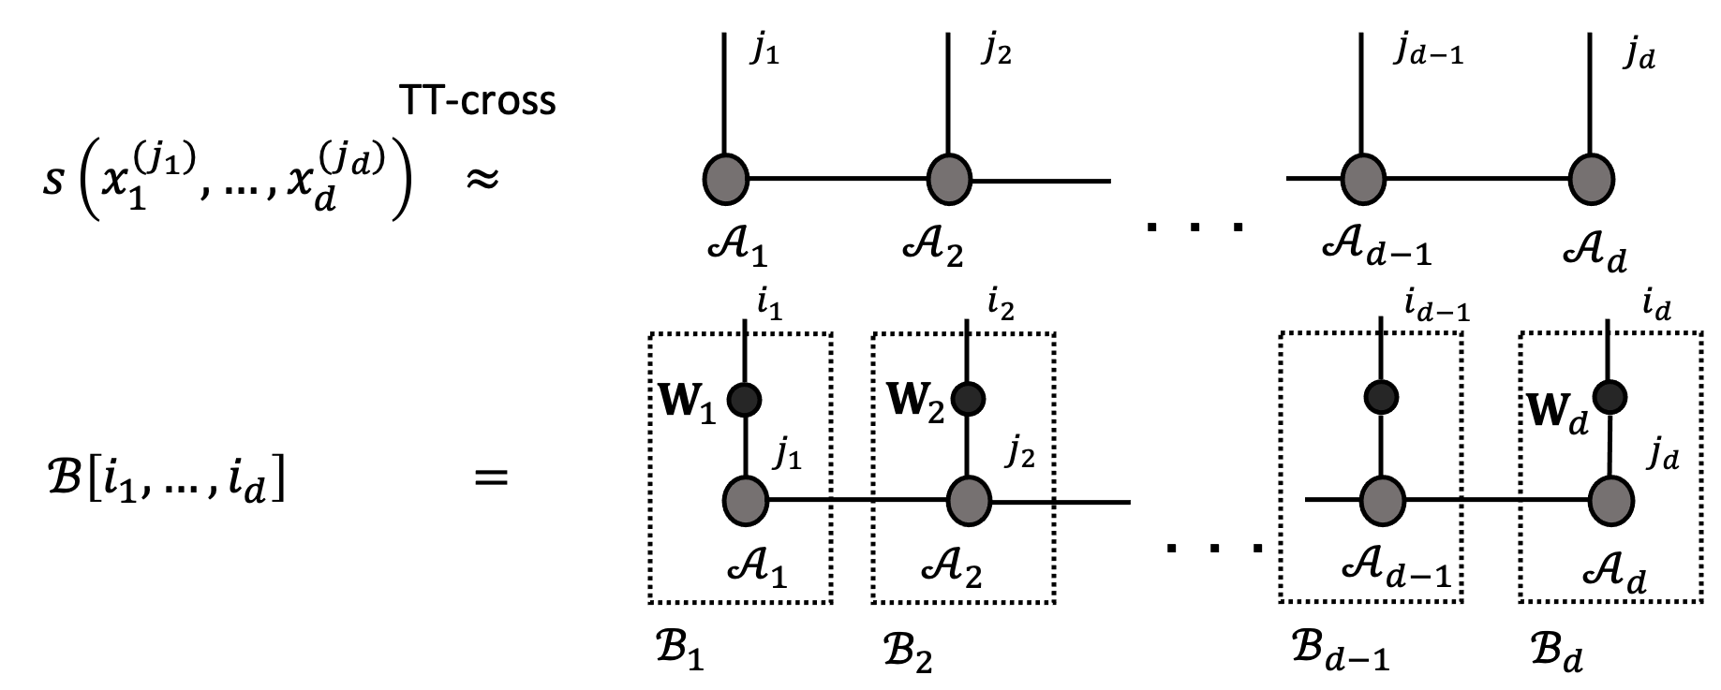
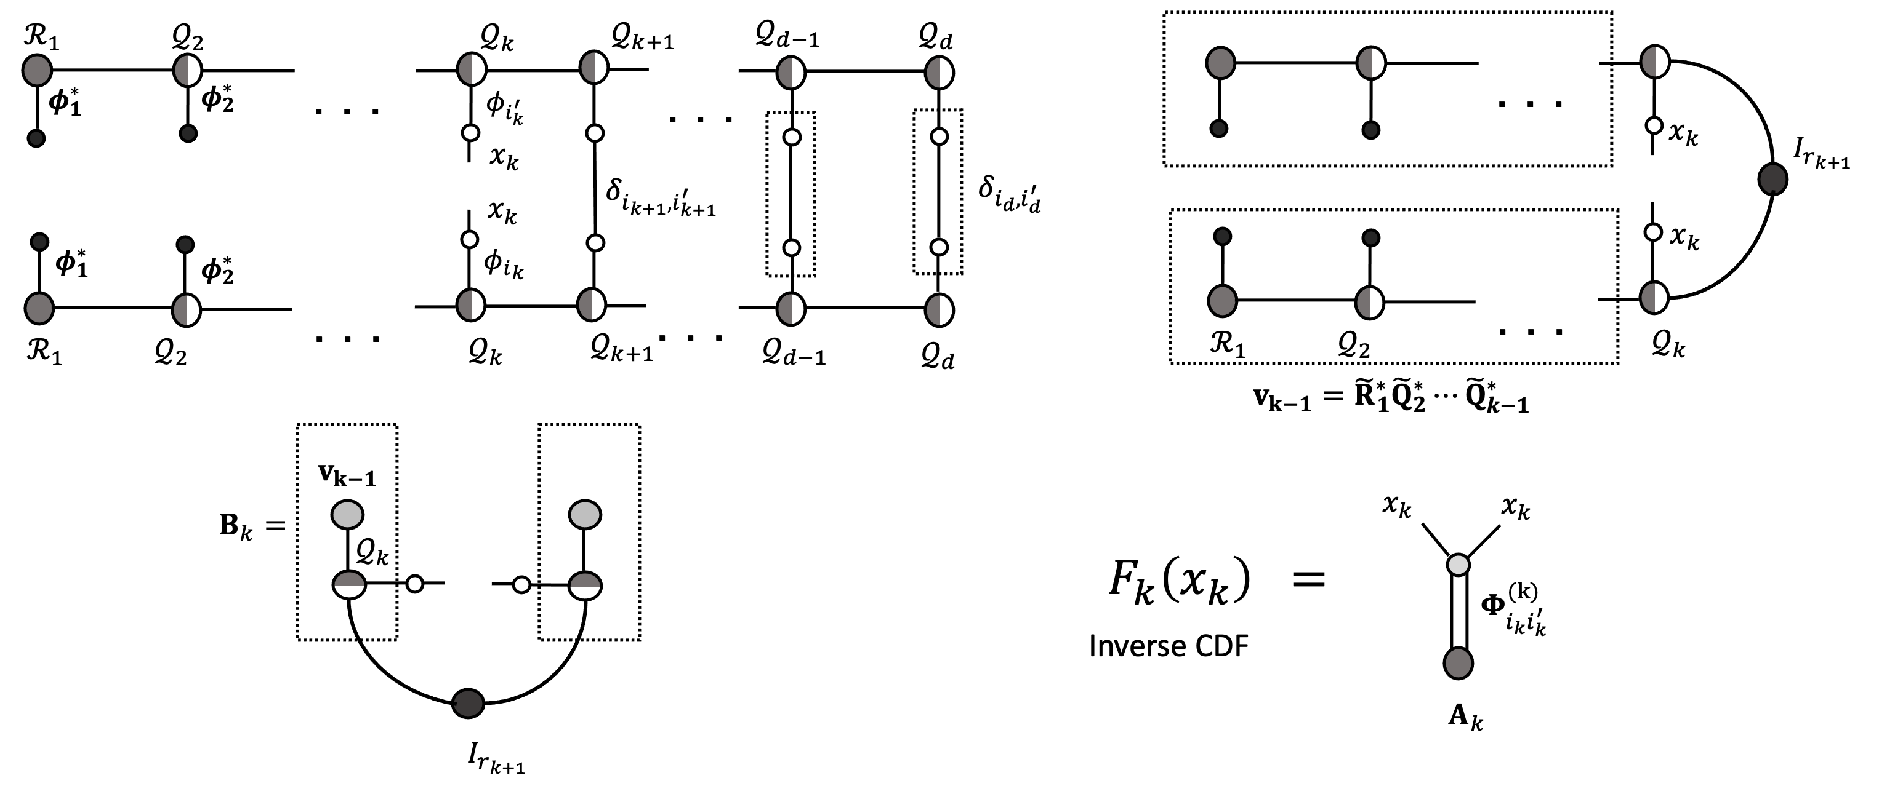
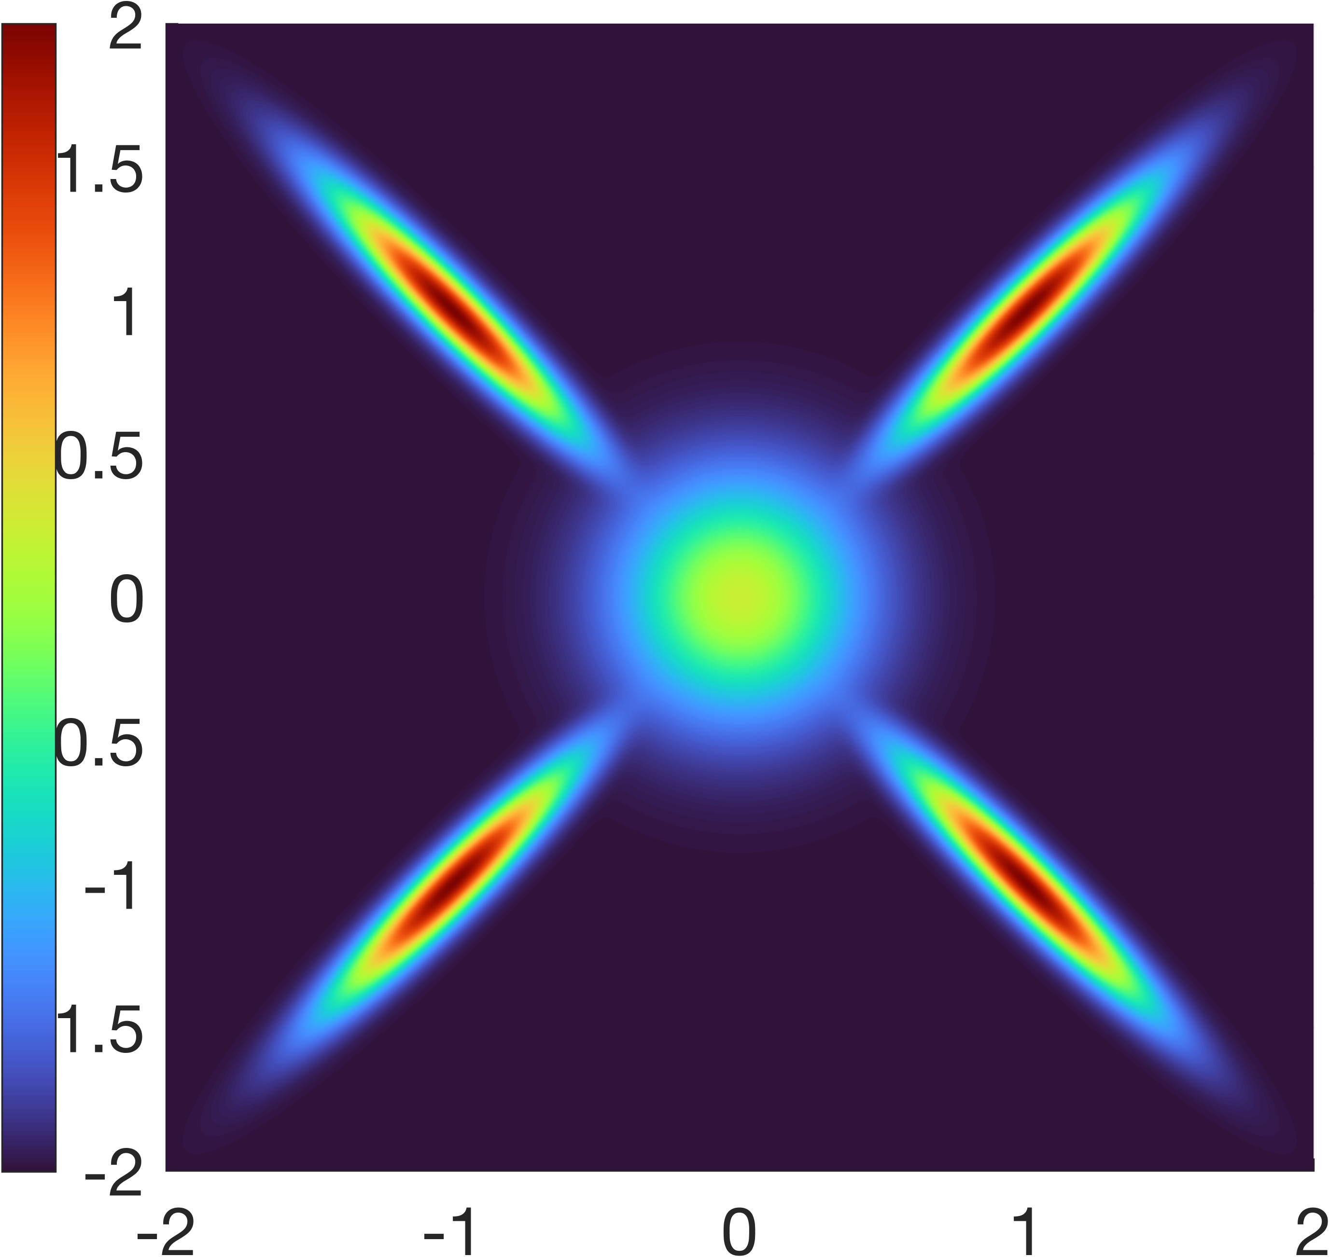
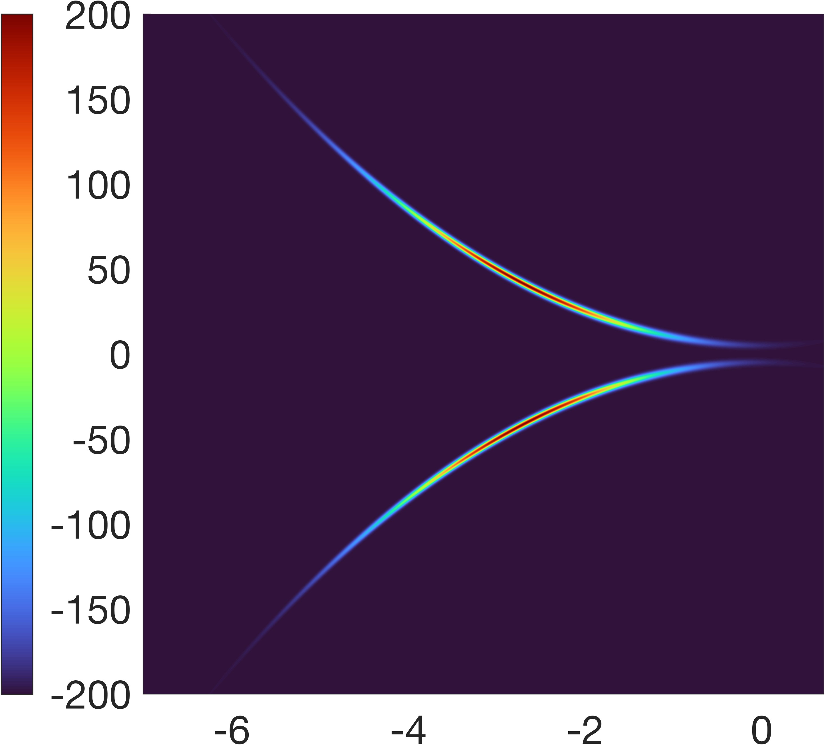
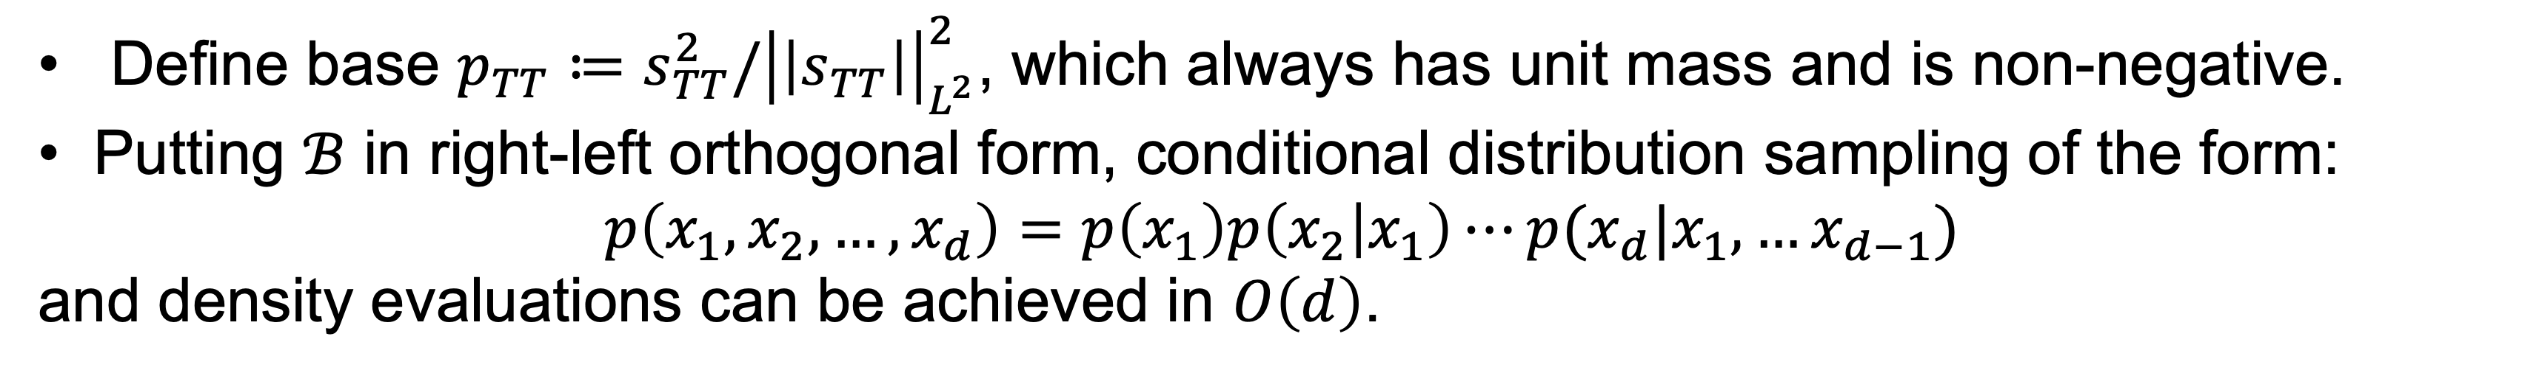

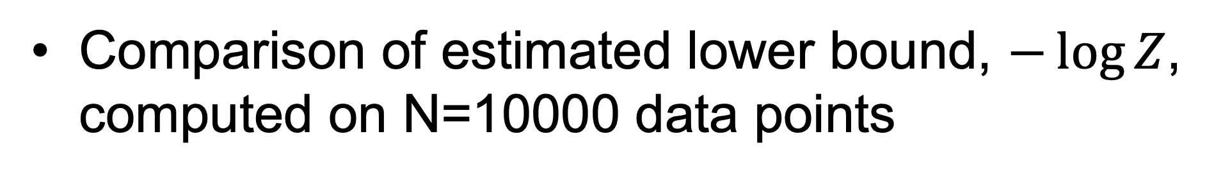
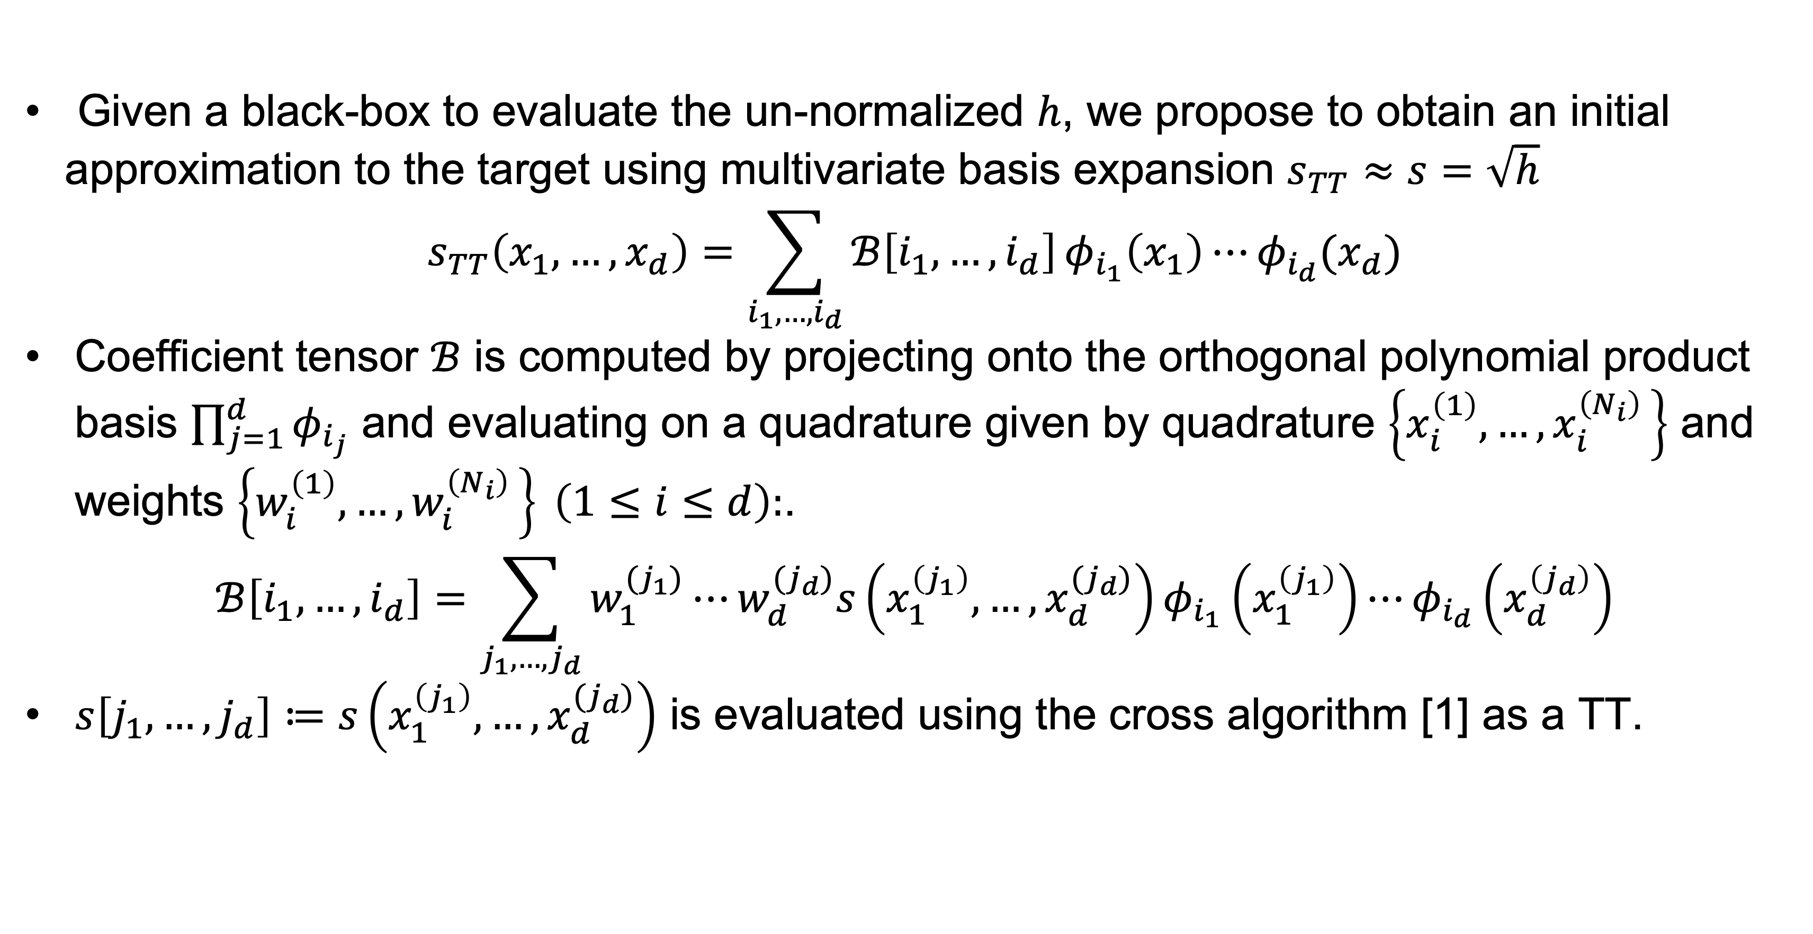
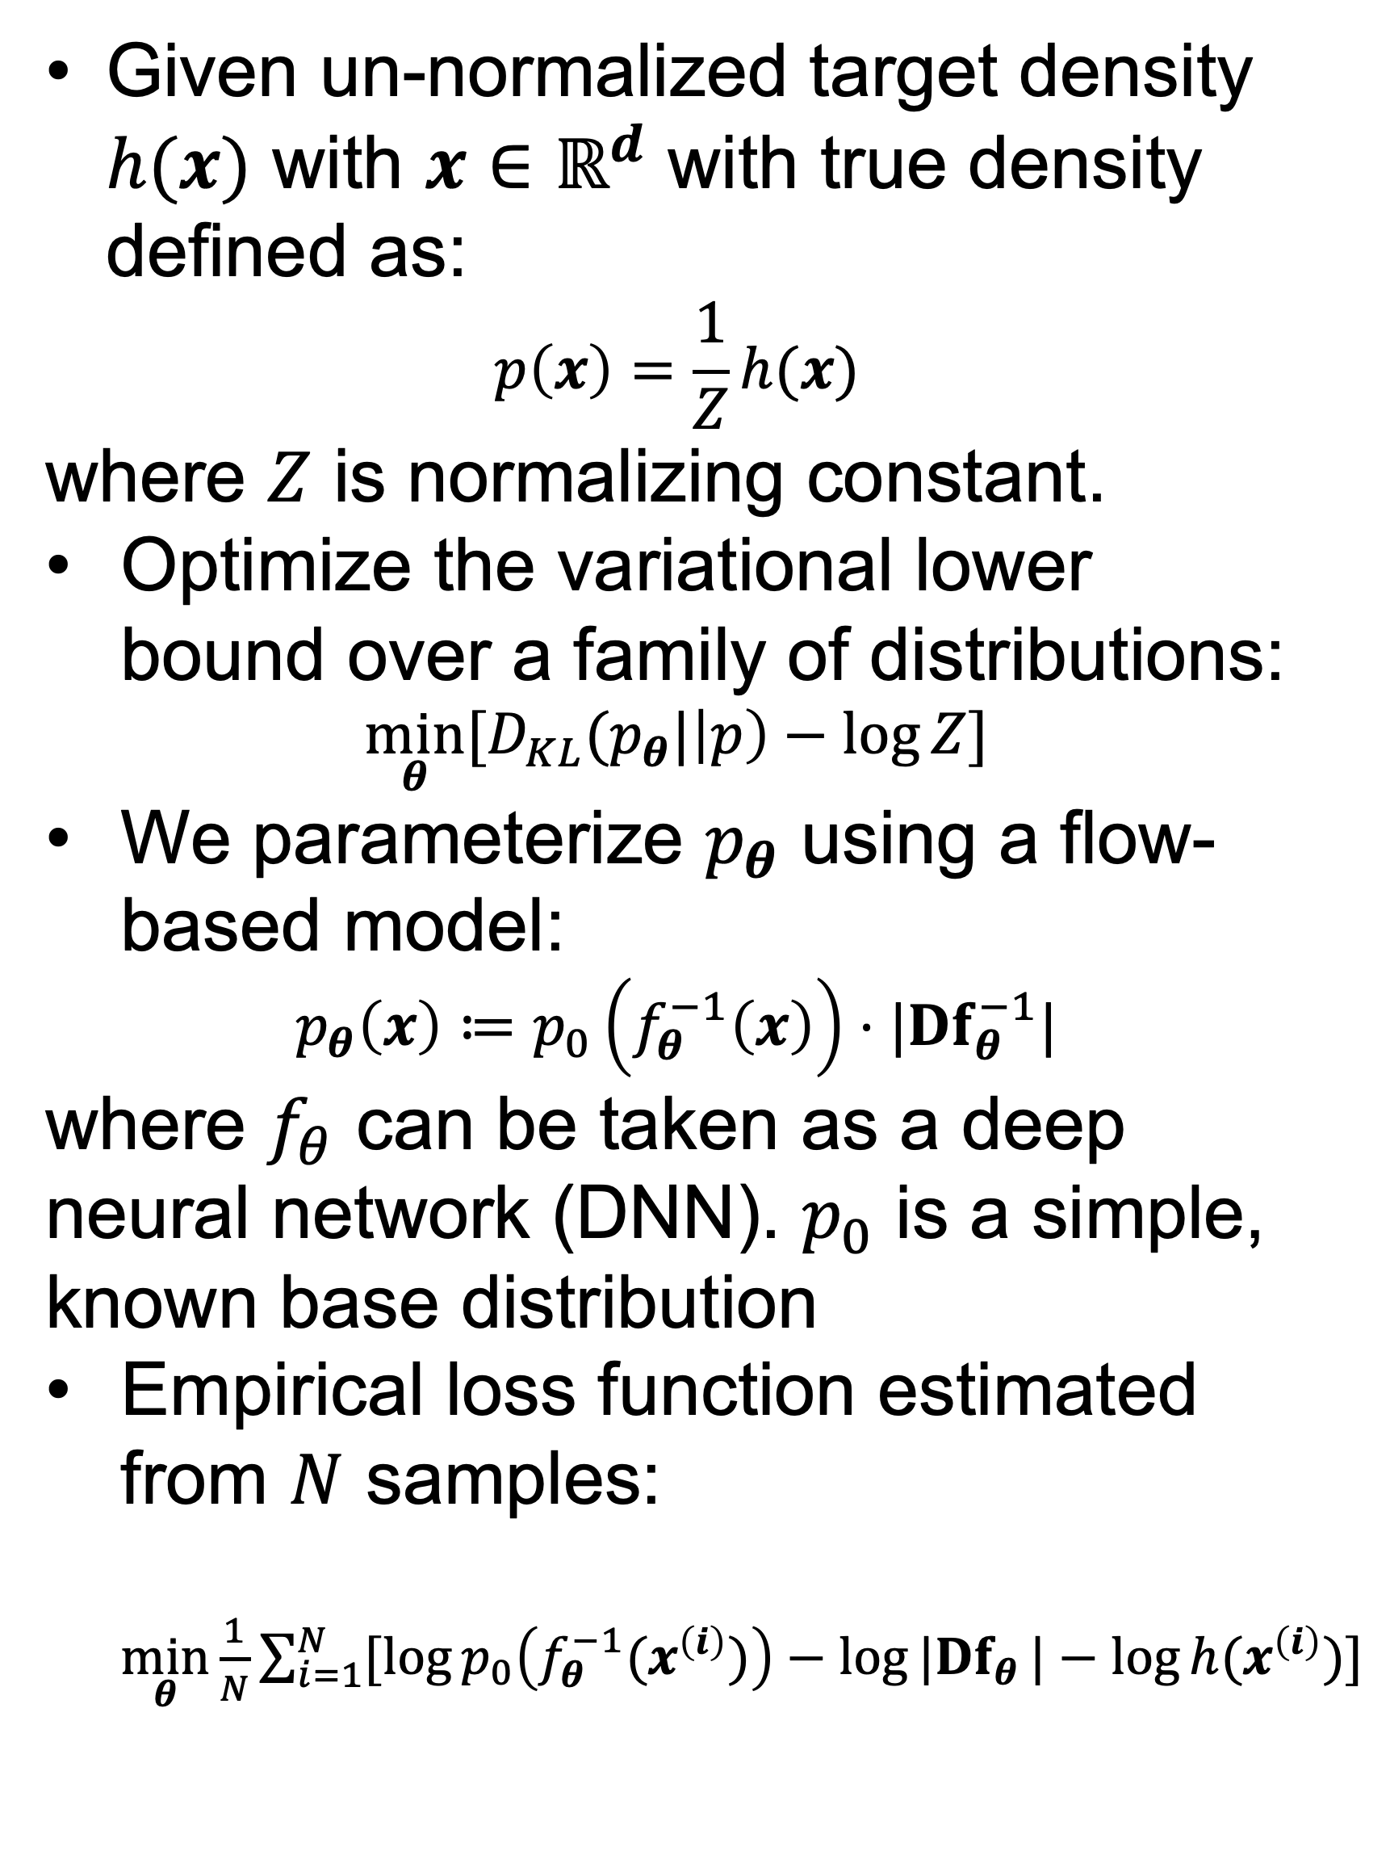
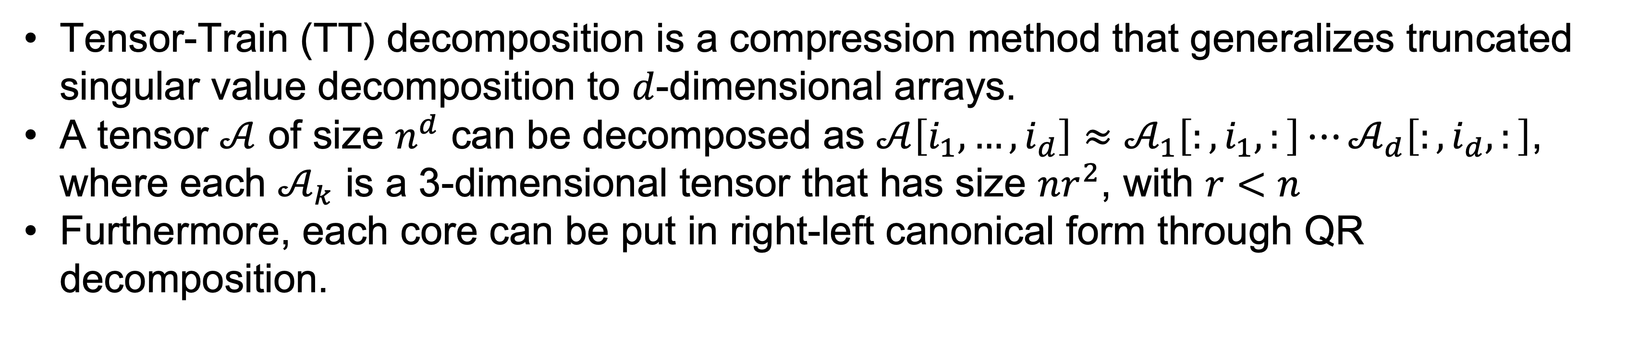
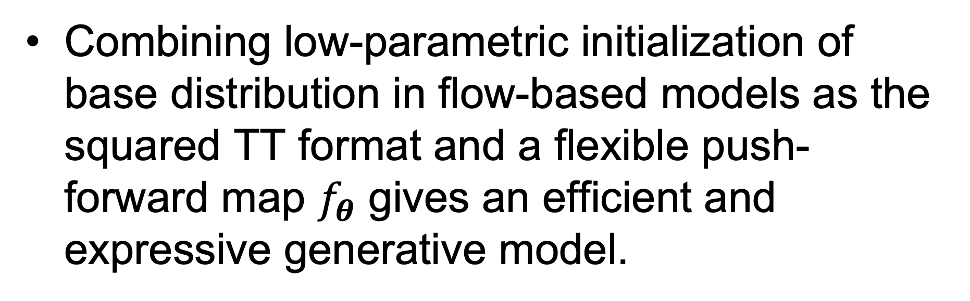

The University of Chicago AI + Science Summer School
Tensorizing-Flow: Generative Modeling with Matrix Product State
August 8th – 12th
Yuehaw Khoo
The University of Chicago, Department of Statistics
Michael Lindsey
University of California, Berkeley, Department of Mathematics
Hongli Zhao
The University of Chicago, Committee on Computational and Applied Mathematics
Motivation
Tensor-Train Decomposition
Accuracy Comparison
Variational Inference (VI) is widely applied in approximating high-dimensional probability distributions from data.
Normalizing Flow (NF) approximates a distribution as pushforward of a base distribution (e.g., Gaussian) via an invertible map
Performance of NF relies on base distribution being absolutely continuous with respect to the target. Difficult to learn when target has complex structure (e.g., multi-modality).
Tensor-train (TT) can represent a high-dimensional distribution in a low-parametric form achievable by linear algebra routines.
We propose to combine TT initialization with the expressiveness of NF to achieve more accurate approximations while supporting efficient sampling and density evaluation.
Tensor-Train (TT) decomposition is a compression method that generalizes truncated singular value decomposition to $d$-dimensional arrays.
A tensor $𝒜$ of size $n^{d}$ can be decomposed as $𝒜\left[i_{1},…,i_{d}\right]≈𝒜_{1}\left[:,i_{1},:\right]⋯𝒜_{d}\left[:,i_{d},:\right]$, where each $𝒜_{k}$ is a 3-dimensional tensor that has size $nr^{2}$, with $r<n$
Furthermore, each core can be put in right-left canonical form through QR decomposition.
Visualization of samples from learned distributions
N=10000 samples from Tensorizing Flow
N=10000 samples from Normalizing Flow
Base Distribution using Squared-TT Ansatz
Given a black-box to evaluate the un-normalized $h$, we propose to obtain an initial approximation to the target using multivariate basis expansion $s_{TT}≈s=\sqrt{h}$
$$s_{TT}\left(x_{1},…,x_{d}\right)=\sum_{i_{1},…,i_{d}}{ℬ\left[i_{1},…,i_{d}\right]}φ_{i_{1}}\left(x_{1}\right)⋯φ_{i_{d}}(x_{d})$$
Coefficient tensor $ℬ$ is computed by projecting onto the orthogonal polynomial product basis $\prod_{j=1}^{d}{φ_{i_{j}}}$ and evaluating on a quadrature given by quadrature $\left\{x_{i}^{\left(1\right)},…,x_{i}^{\left(N_{i}\right) }\right\}$ and weights $\left\{w_{i}^{\left(1\right)},…,w_{i}^{\left(N_{i}\right) }\right\} \left(1≤i≤d\right):$.
$$ℬ\left[i_{1},…,i_{d}\right]=\sum_{j_{1},…,j_{d}}{w_{1}^{(j_{1})}⋯w_{d}^{{(j}_{d})}s\left(x_{1}^{\left(j_{1}\right)},…,x_{d}^{{(j}_{d})}\right)φ_{i_{1}}\left(x_{1}^{\left(j_{1}\right)}\right)⋯φ_{i_{d}}\left(x_{d}^{\left(j_{d}\right)}\right)}$$
$s\left[j_{1},…,j_{d}\right]≔s\left(x_{1}^{\left(j_{1}\right)},…,x_{d}^{{(j}_{d})}\right)$ is evaluated using the cross algorithm [1] as a TT.
N=10000 samples from Tensorizing Flow
N=10000 samples from Normalizing Flow
Comparison of estimated lower bound, $−\log{Z}$, computed on N=10000 data points
Inference Model
Given un-normalized target density $h(x)$ with $x∈ℝ^{d}$ with true density defined as:
$$p\left(x\right)=\frac{1}{Z}h(x)$$
where $Z$ is normalizing constant.
Optimize the variational lower bound over a family of distributions:
$$\min_{θ}[D_{KL}(p_{θ}|\left|p\right)−\log{Z}]$$
We parameterize $p_{θ}$ using a flow-based model:
$$p_{θ}\left(x\right)≔p_{0}\left(f_{θ}^{−1}\left(x\right)\right)⋅|Df_{θ}^{−1}|$$
where $f_{θ}$ can be taken as a deep neural network (DNN). $p_{0}$ is a simple, known base distribution
Empirical loss function estimated from $N$ samples: $\min_{θ}\frac{1}{N}\sum_{i=1}^{N}{[\log{p_{0}\left(f_{θ}^{−1}(x^{\left(i\right)})\right)−\log{|Df_{θ}}|−\log{h(x^{\left(i\right)})}}}]$
Mixture Gaussian distribution
Double Rosenbrock function
Tensorizing-Flow
Combining low-parametric initialization of base distribution in flow-based models as the squared TT format and a flexible push-forward map $f_{θ}$ gives an efficient and expressive generative model.
Computing coefficient tensor
Define base $p_{TT}≔s_{TT}^{2}/{\left|\left|s_{TT}\right|\right|}_{L^{2}}^{2}$, which always has unit mass and is non-negative.
Putting $ℬ$ in right-left orthogonal form, conditional distribution sampling of the form:
$$p\left(x_{1},x_{2},…,x_{d}\right)=p\left(x_{1}\right)p\left(x_{2} | x_{1}\right)⋯p(x_{d}|x_{1},…x_{d−1})$$
and density evaluations can be achieved in $O\left(d\right)$.
${(x}_{29},x_{30})$-plane
${(x}_{10},x_{11})$-plane
Future Work
General learning tasks where model response is required to be non-negative.
More complex kernel functions.
References
Schema for conditional distribution sampling
[1] Oseledets et al., TT-cross approximation for multidimensional arrays
Squared TT reconstruction of high-dimensional distributions.
Left: mixture Gaussian (d=30), Right: double Rosenbrock function (d=11)

